Slide 1

Ideological Rifts between The British Empire and the Colonies

Slide 2
Influences
Natural Rights Philosophy
The influence of the Radical Whigs in England
Classical Republicanism

Slide 3
Two Political Philosophies Emerge in the 17th and 18th Century

Slide 4
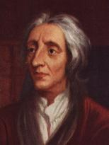
Natural Rights Philosophy
John Locke (1632-1704)
Part of Enlightenment thought
“State of nature”
Rights that exist: life, liberty, property
Rights are inalienable (unalienable)

Slide 5

Natural Rights Philosophy
“Social contract” theory
Government only legitimate if “consent of the governed”
Limited government: by laws, customs = constitution
Right to revolution (if unsatisfied with the “contract”)

Slide 6
Natural Rights Philosophy
Emphasizes the individual
Stresses individual rights
Proposes small government, with limited powers
Changeable government

Slide 7



What does Natural Rights philosophy say about...?
Taxes
Private property
Gun ownership
Amendment 64

Slide 8
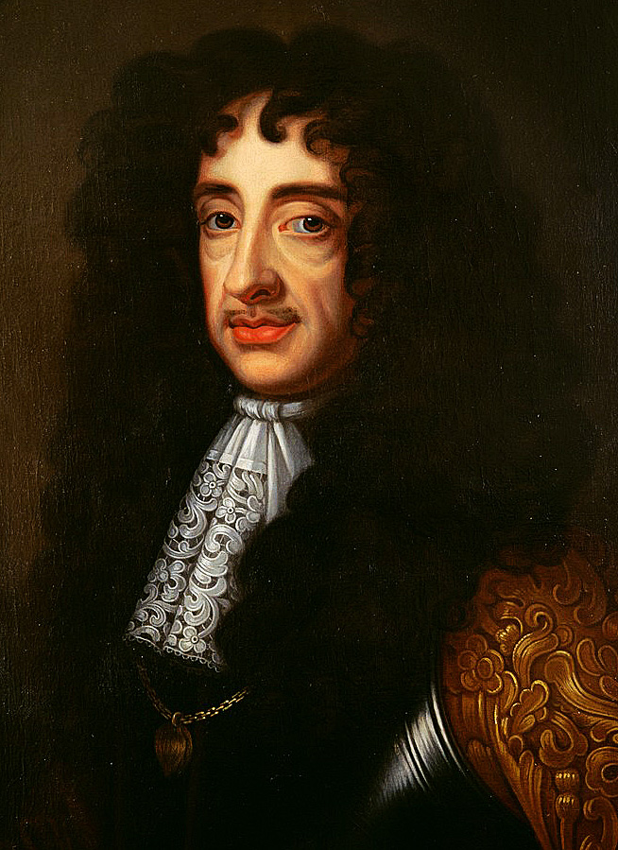
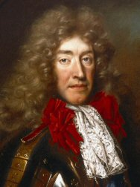
The Radical Whigs
“Whigs” = anti-monarchy
Grew up in 1670s and 1680s
Centered in Parliament
They wanted to start a Republic
Stood in opposition to absolute power of Charles II
Afraid that Charles’s brother, James (a Catholic) would get the throne
Charles II
James II

Slide 9

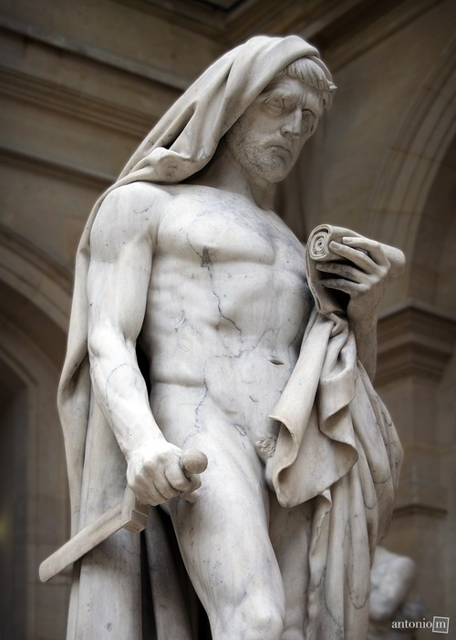
Conspiracy Theorists
Saw “absolutist” conspirators trying to work their way into the ministry to install a tyranny under the King’s nose
This would lead to corruption
In order to avoid corruption, a person had to be “virtuous” just like Cato
Cato the Younger,
a martyr for the cause of the Roman Republic

Slide 10
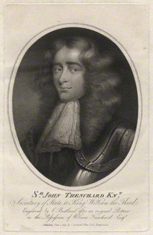
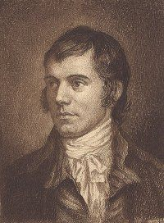
What They Worried About
Increased debt of Britain
Increased taxation
Creation of a standing army at the service of the King
Once the conspirators did this, they would begin to take away other rights such as trial by jury and property rights
They wrote about their worries in newspapers, books and pamphlets (Cato’s Letters)
John Trenchard
Thomas Gordon

Slide 11
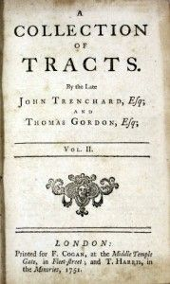
So What
The British public were not interested, so merchants unloaded the pamphlets in America
The colonists, on the other hand, were very literate, loved to read, did not have access to the most popular titles in England
As Britain put the screws on America, the pamphlets seemed to confirmed their conspiracy theories

Slide 12
Classical Republicanism
Looks back to the examples of Ancient Greece and Rome
Democracy (Greek demos = people)
Direct democracy (will of the majority)

Slide 13
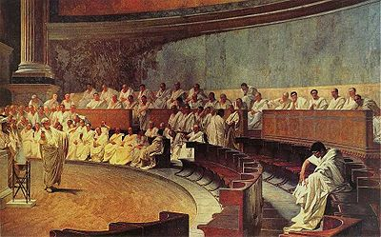
Classical Republicanism
Roman Republic for 500 years (509 B.C.-27 B.C.)
Res publicae (“thing of the people”)

Slide 14
Characteristics of a Republic
Political authority shared by citizens, not hereditary monarch
Political authority through chosen representatives

Slide 15
Assumptions
Form of government devoted to promoting the “common good” (what is best for society as a whole)
Provided the most liberty under government ever known

Slide 16
Requirements for a Republic
Small area
Homogeneous populations (similar religion, language, interests)
Virtuous population committed to the “common good”

Slide 17
Requirements for a Republic
Civic “virtue” = public-spiritedness
Moral education
Uniform communities
Established religion
No factions = special interest groups

Slide 18
Requirements for a Republic
People who are “disinterested” (can’t be bought)
“Interest” in the public good
No “self-interest” = the biggest danger
No “special interests” = “Factions”

Slide 19
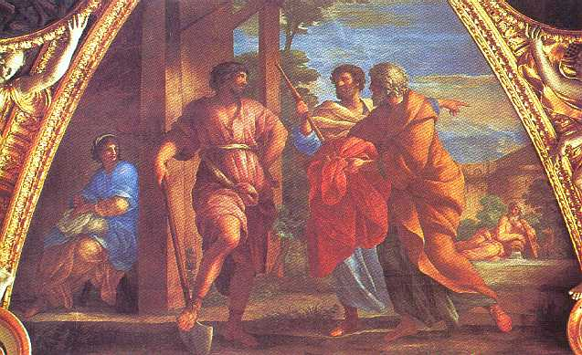
Cincinnatus
Left his plow to save the Roman Republic
Relinquished his public role and returned to private life

Slide 20
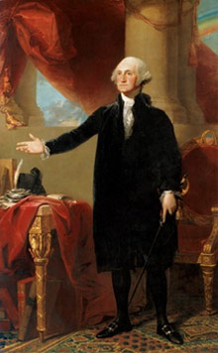
George Washington
Led revolutionary army
Reluctantly served as president
Stepped down after two terms
sets precedent for all presidents up until FDR!

